Slide 1
Logistic Regression Pre-Work
Pre-work: Watch the video to understand how cost function and respective derivative is calculated for logistic regression: https://www.youtube.com/watch?v=CE03E80wbRE
Review following articles to learn how to implement LR from Scratch:
https://towardsdatascience.com/building-a-logistic-regression-in-python-301d27367c24
https://medium.com/@martinpella/logistic-regression-from-scratch-in-python-124c5636b8ac
Notes:
https://medium.com/@martinpella/logistic-regression-from-scratch-in-python-124c5636b8ac
https://towardsdatascience.com/building-a-logistic-regression-in-python-301d27367c24

Slide 2
Logistic Regression The Logistic function
Set up T4 Machine – 15 min
Progress check – 5 min
Logistic function – 15 min
Cost function – 15 min
Cost function intuition – 15 min
Gradient Descent – 15 min
Hands on – 45 min
Assignment – 5 min
Notes:
https://medium.com/@martinpella/logistic-regression-from-scratch-in-python-124c5636b8ac
https://towardsdatascience.com/building-a-logistic-regression-in-python-301d27367c24

Slide 3
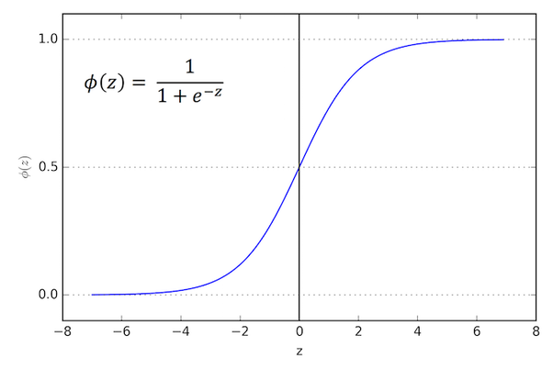
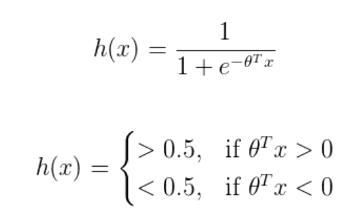
Logistic Function Hypothesis & Sigmoid function
Φ(z) tends towards 1 as z→∞
Φ(z) tends towards 0 as z→ -∞
Φ(z) is always bounded between 0 and 1
Notes:
http://fooplot.com/ - Link to play around with function curve

Slide 4
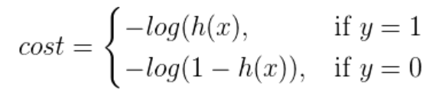
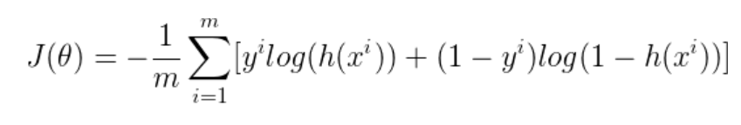
Cost function
Notes:
https://math.stackexchange.com/questions/477207/derivative-of-cost-function-for-logistic-regression

Slide 5
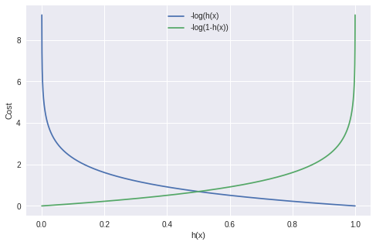
Cost function Intuition
ID | BtX | Sigmoid | Cost if 1 | Cost if 0
1 | -10 | 0.00 | 4.34 | 0.00
2 | -9 | 0.00 | 3.91 | 0.00
3 | -8 | 0.00 | 3.47 | 0.00
4 | -7 | 0.00 | 3.04 | 0.00
5 | -6 | 0.00 | 2.61 | 0.00
6 | -5 | 0.01 | 2.17 | 0.00
7 | -4 | 0.02 | 1.75 | 0.01
8 | -3 | 0.05 | 1.32 | 0.02
9 | -2 | 0.12 | 0.92 | 0.06
10 | -1 | 0.27 | 0.57 | 0.14
11 | 0 | 0.50 | 0.30 | 0.30
12 | 1 | 0.73 | 0.14 | 0.57
13 | 2 | 0.88 | 0.06 | 0.92
14 | 3 | 0.95 | 0.02 | 1.32
15 | 4 | 0.98 | 0.01 | 1.75
16 | 5 | 0.99 | 0.00 | 2.17
17 | 6 | 1.00 | 0.00 | 2.61
18 | 7 | 1.00 | 0.00 | 3.04
19 | 8 | 1.00 | 0.00 | 3.47
20 | 9 | 1.00 | 0.00 | 3.91
21 | 10 | 1.00 | 0.00 | 4.34
Notes:
https://math.stackexchange.com/questions/477207/derivative-of-cost-function-for-logistic-regression

Slide 6
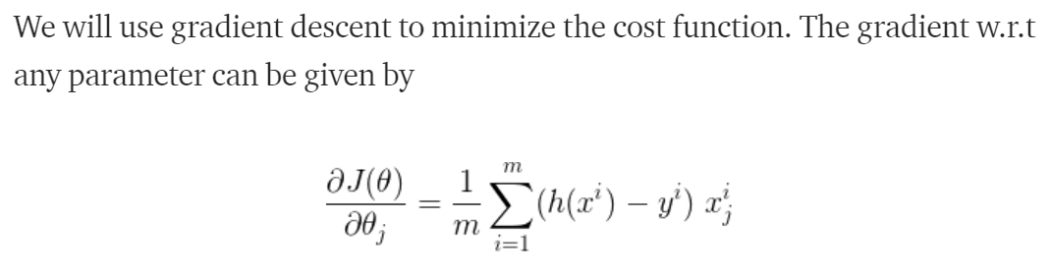
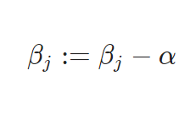
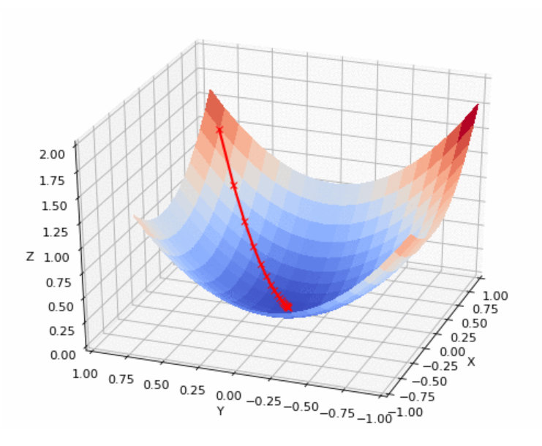
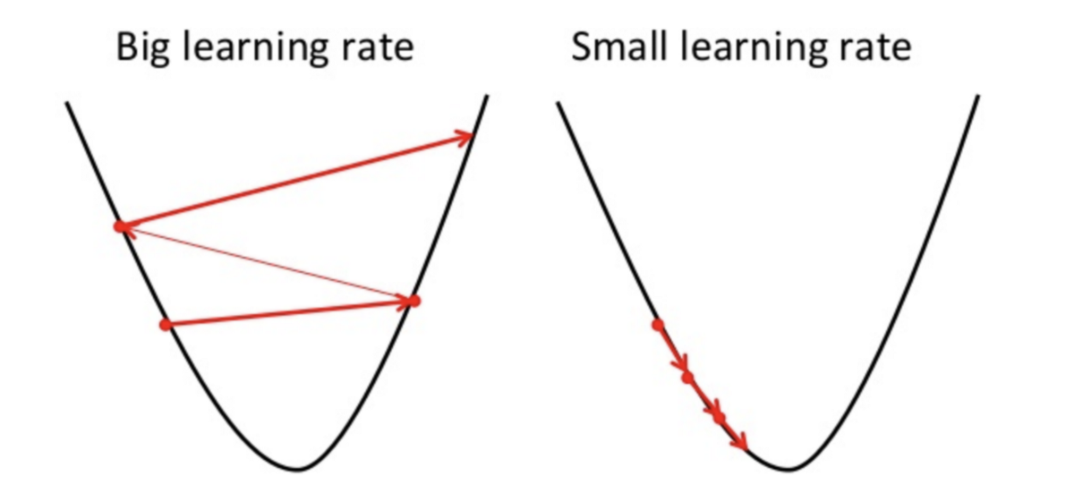
Gradient Descent
Iteratively update Bj

Slide 7
Assignment – Due by 18th June
Enroll into titanic Kaggle competition and use logistic regression to find out the survival rate. Report your leader board score. What is your accuracy?

Slide 8
Assumptions
In SGD, before for-looping, you need to randomly shuffle the training examples – This makes it stochastic
In SGD, because it’s using only one example at a time, its path to the minima is noisier (more random) than that of the batch gradient. But it’s ok as we are indifferent to the path, as long as it gives us the minimum AND the shorter training time.
Mini-batch gradient descent uses n data points (instead of 1 sample in SGD) at each iteration.
Unlike the batch gradient descent which computes the gradient using the whole dataset, because the SGD, also known as incremental gradient descent, tries to find minimums or maximums by iteration from a single randomly picked training example, the error is typically noisier than in gradient descent.
However, this can also have the advantage that stochastic gradient descent can escape shallow local minima more easily.
In order to obtain accurate results with stochastic gradient descent, the data sample should be in a random order, and this is why we want to shuffle the training set for every epoch.
The way this optimization algorithm works is that each training instance is shown to the model one at a time. The model makes a prediction for a training instance, the error is calculated and the model is updated in order to reduce the error for the next prediction.
Notes:
https://towardsdatascience.com/difference-between-batch-gradient-descent-and-stochastic-gradient-descent-1187f1291aa1

Slide 9
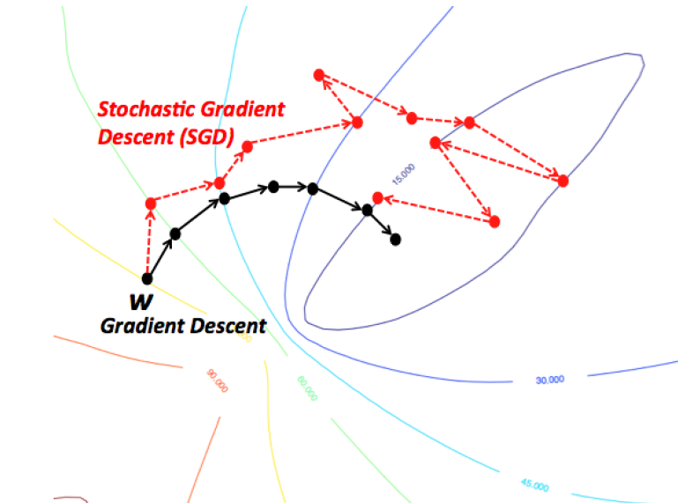
Stochastic Gradient Descent Vs Gradient Descent Vs Mini-batch gradient descent
Do you see np.dot(X.T, y_hat-y) above? That’s the vectorized version of “looping through (summing) 3 million samples”.
Wait.. just to move a single step towards the minimum, do we really have to calculate each cost 3 million times?
Notes:
https://towardsdatascience.com/difference-between-batch-gradient-descent-and-stochastic-gradient-descent-1187f1291aa1

